Slide 1
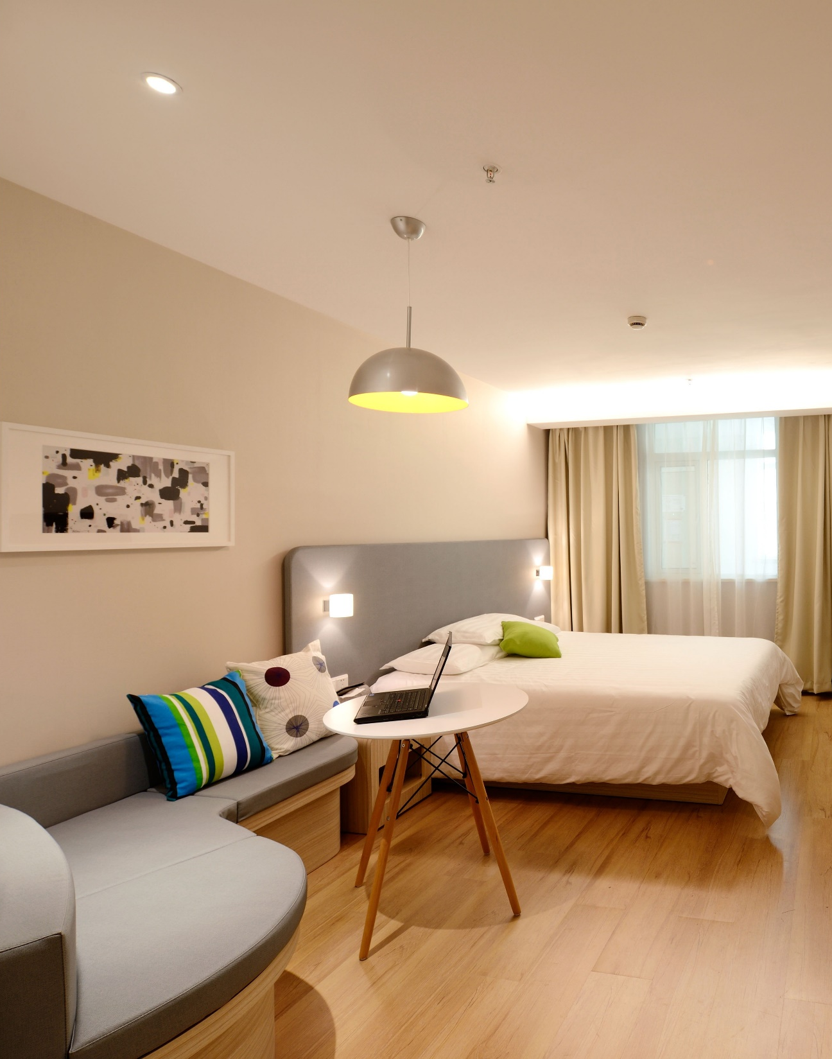

Data Story Telling
Belong Anywhere.
Created by:
K.G.Samprit
Nurshafizah Mohd Kamil

Slide 2
Objective
Agenda
Background
Key Findings
Recommendations
Other Insights

Slide 3

Objectives
To understand some important insights based on various attributes in the dataset so as to increase the revenue.
To analyse customer preferences based on the attributes such as pricing to improve customer experiences.
To provide recommendations to the company on future marketing and acquisitions.

Slide 4

Backgrounds
For the past few months, Airbnb has seen a major decline in revenue.
Now that the restrictions have started lifting and people have started to travel more, Airbnb wants to make sure that it is fully prepared for this change.
So, analysis has been done on a dataset consisting of various AirBnb, Inc. listings in New York.

Slide 5

Key Findings
Belong Anywhere.

Slide 6
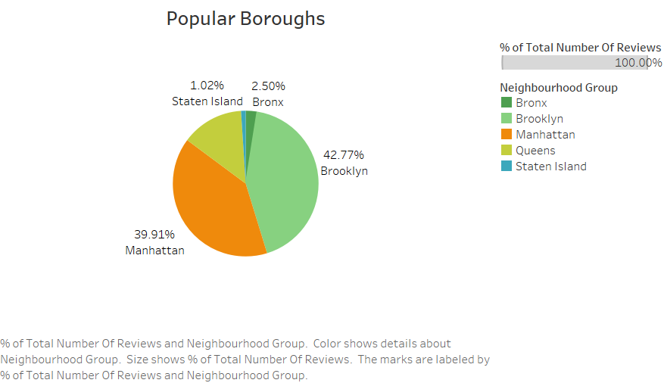
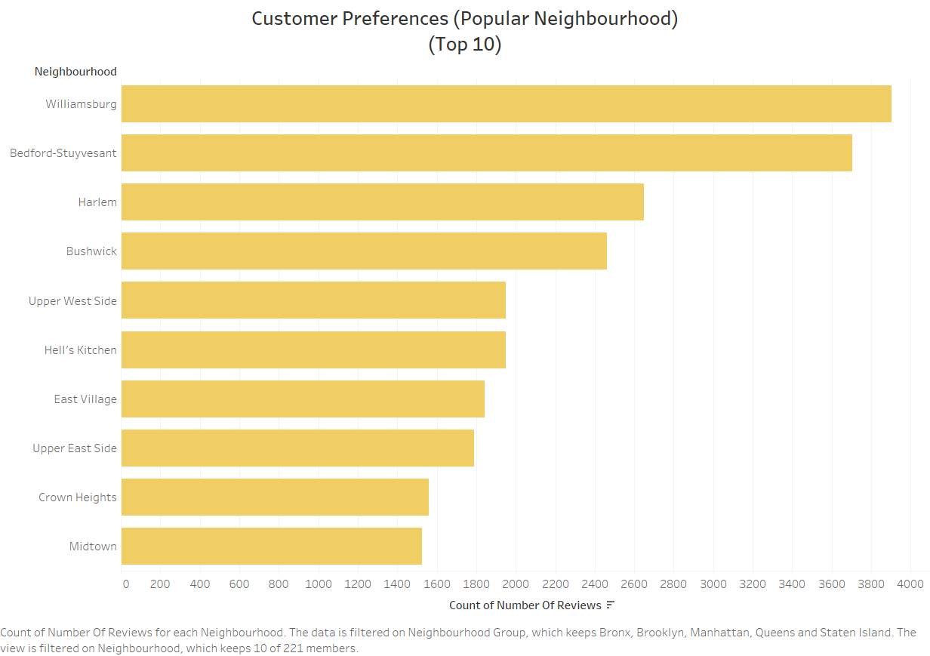
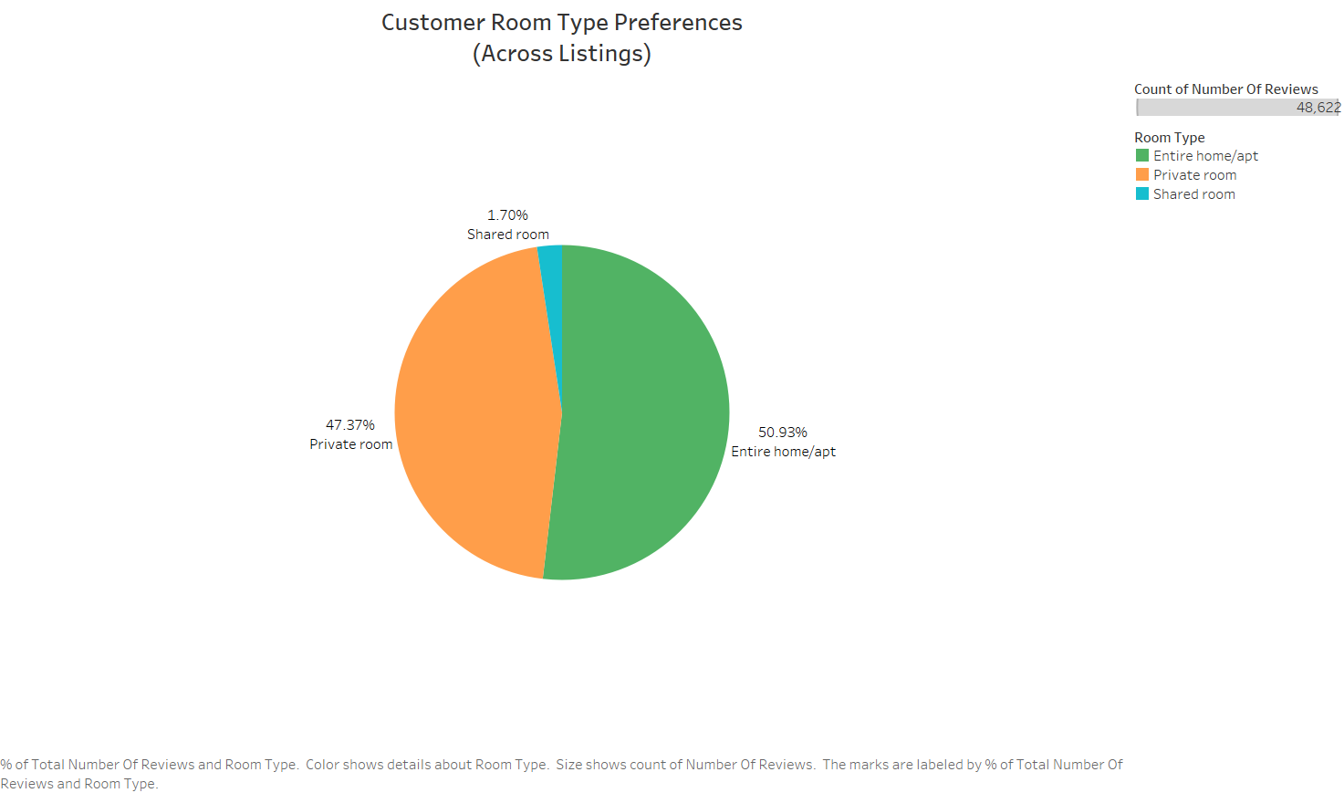
Customer Preferences
Popular Boroughs
Popular Neighbourhood
Popular Property Type
Brooklyn is the most famous borough with 42.77%. Followed by Manhattan with 39.91%.
Williamsburg is the most neighbourhood.
Most of the booking in AirBNB are for Entire home/apt.
6

Slide 7
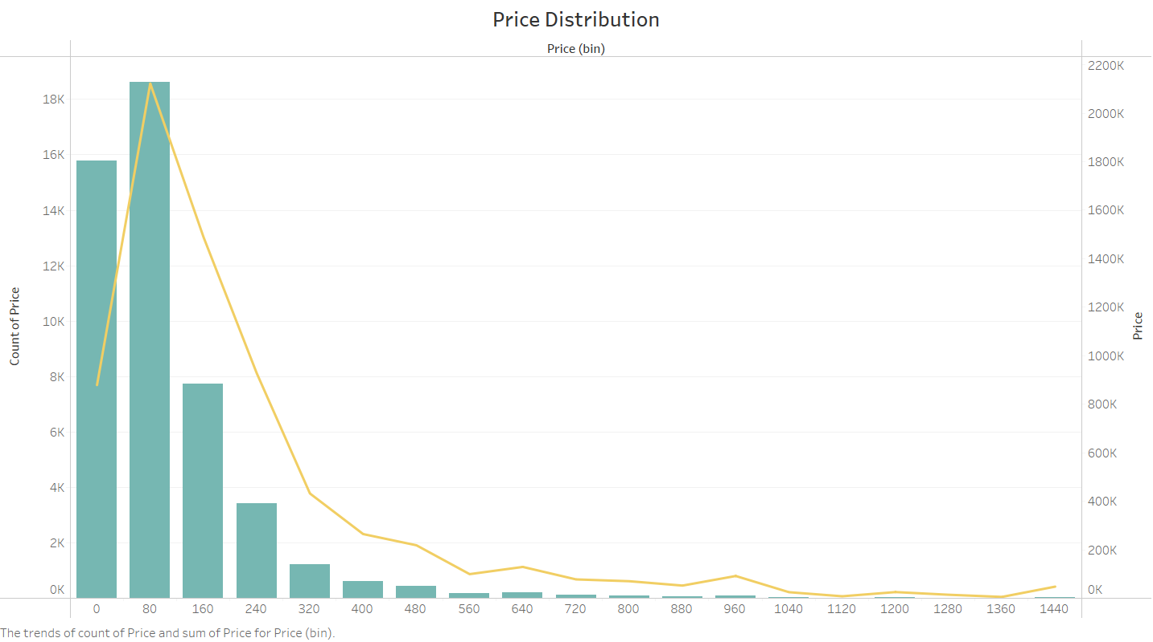
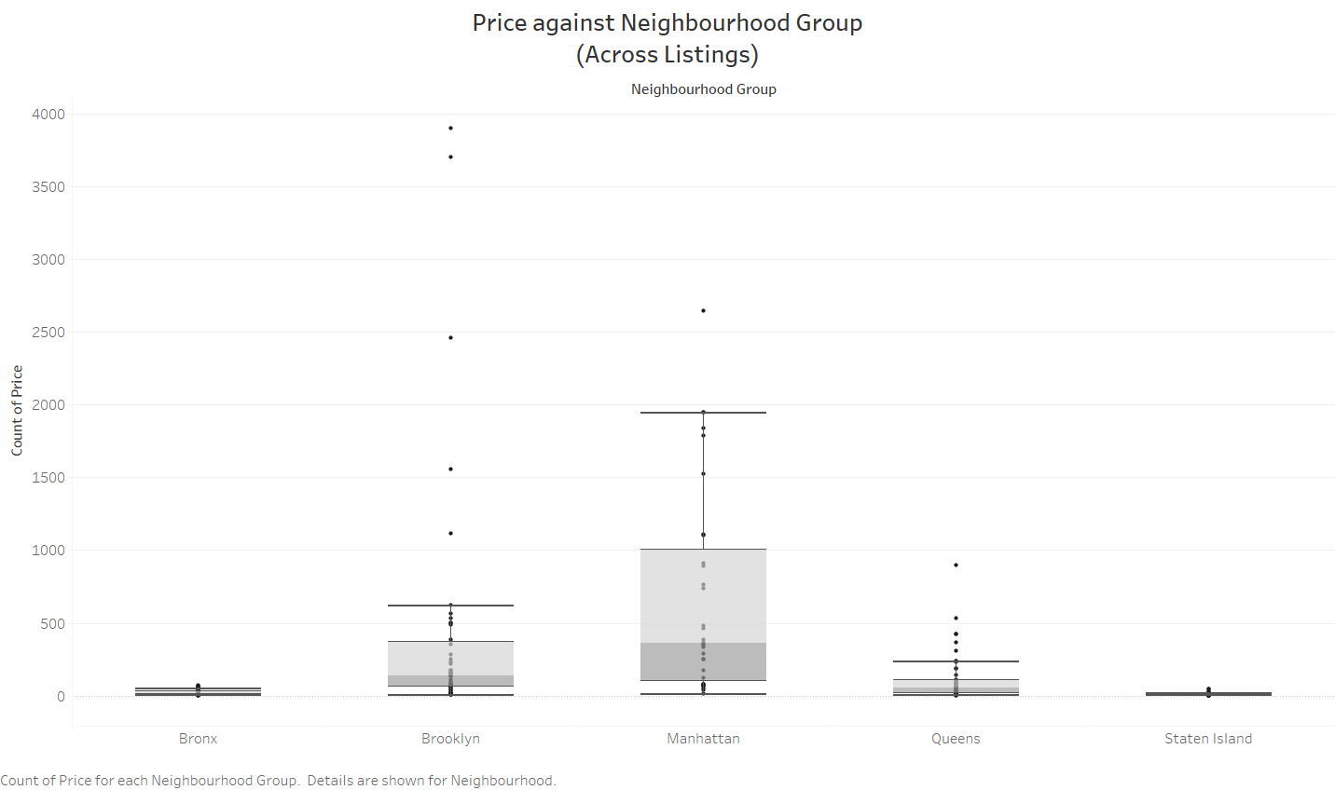
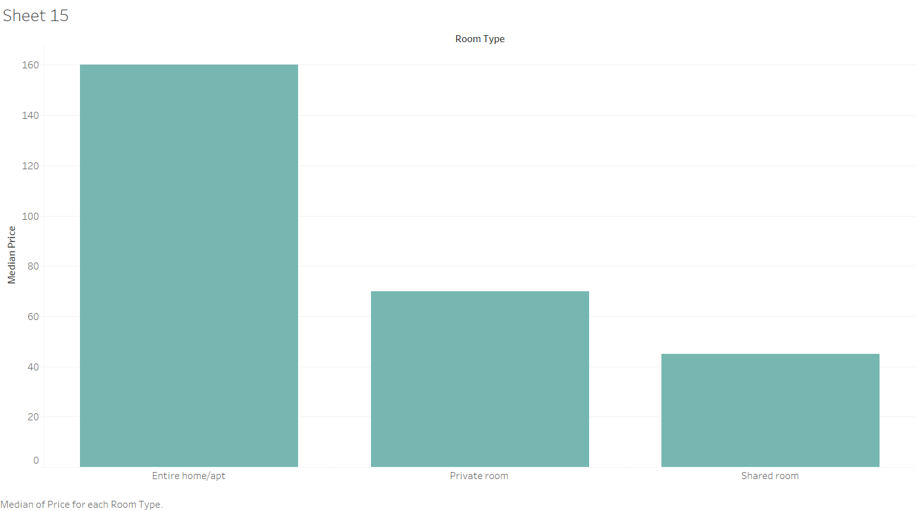
Pricing Perspectives
Pricing Distribution
Pricing Distribution Across Neighbourhood
Pricing Distribution Across Property Type
Famous price range are between 0-80usd.
Manhattan is the costliest, followed by Brooklyn.
Entire Home/Apt cost much greater that Private Room and Shared Room.
7

Slide 8
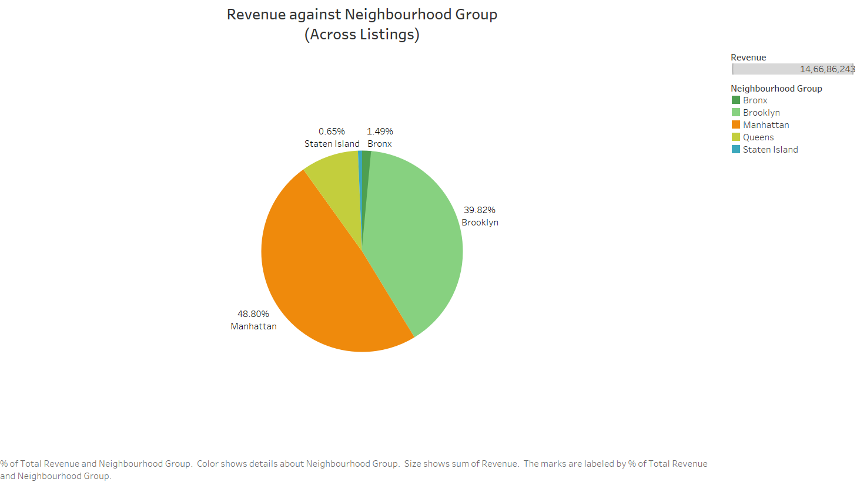
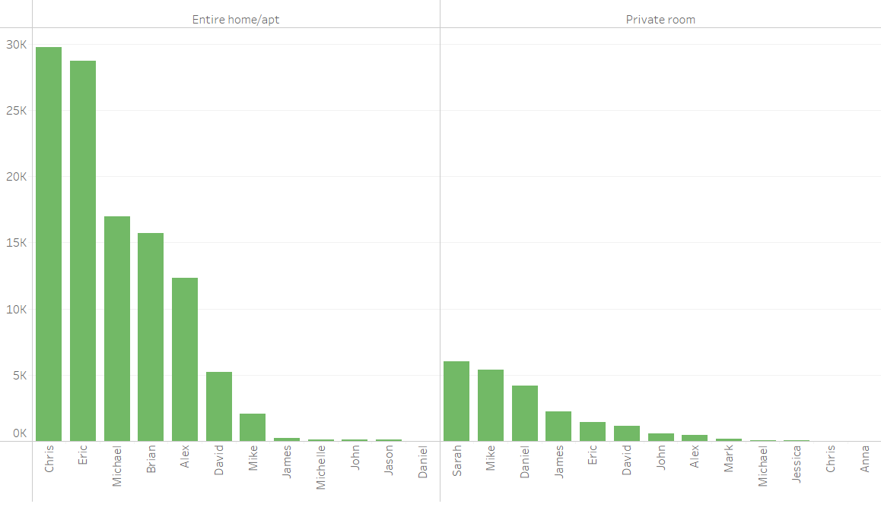
Revenue Generations
Top Revenue (Boroughs)
Top Revenue (Host)
Manhattan generated the highest Revenue with 48.80% followed by Brooklyn with 39.82%.
Chris and Eric are the top revenue generate host for property type Entire Home/Apt.
8

Slide 9

Prime Locations
Focus on prime locations like Manhattan and Brooklyn were people show more interest.
Recommendations
Book Rooms With Locals, Rather than Hotels.
Potential Queens
Queens are very potential boroughs, due to the main airports especially on festive seasons.
Price
Hosting's of lesser Prices should be acquired as customers mostly prefer lower price.

Slide 10

Recommendations 2.0
Belong Anywhere.
Property
More marketing and listings should be focused on Entire Home/Apt.
Night Stays
More Review, More Money
Marketing strategies to encourage longer night stays.
AirBnb/ Host should encourage their customers to provide feedback.

Slide 11
Appendixes
Belong Anywhere.

Slide 12
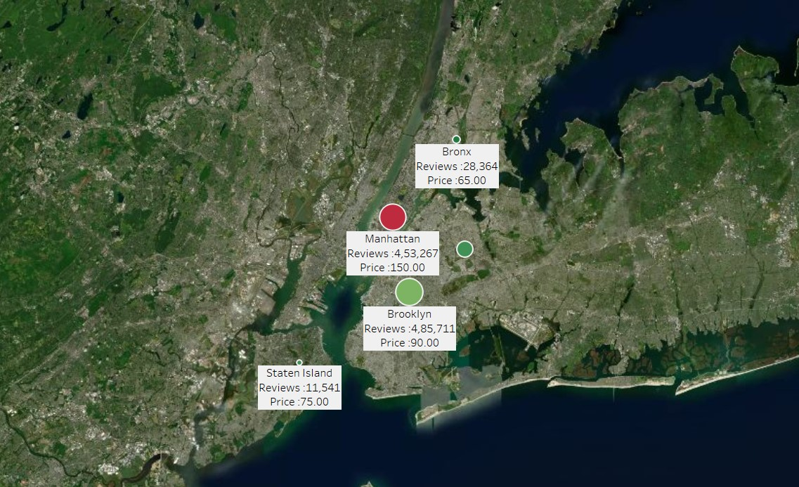


Other Insights
The distribution of pricing and reviews across boroughs.
Manhattan and Brooklyn leads with top reviews, however with high price as well.

Slide 13
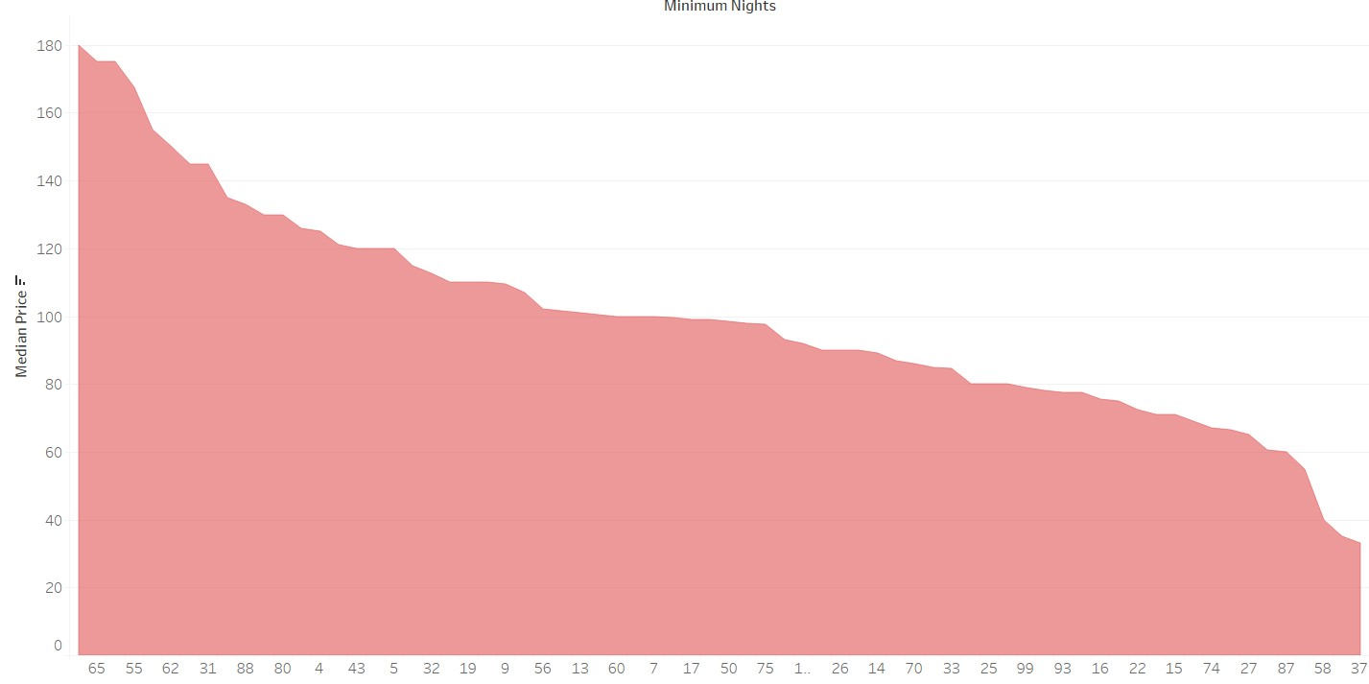
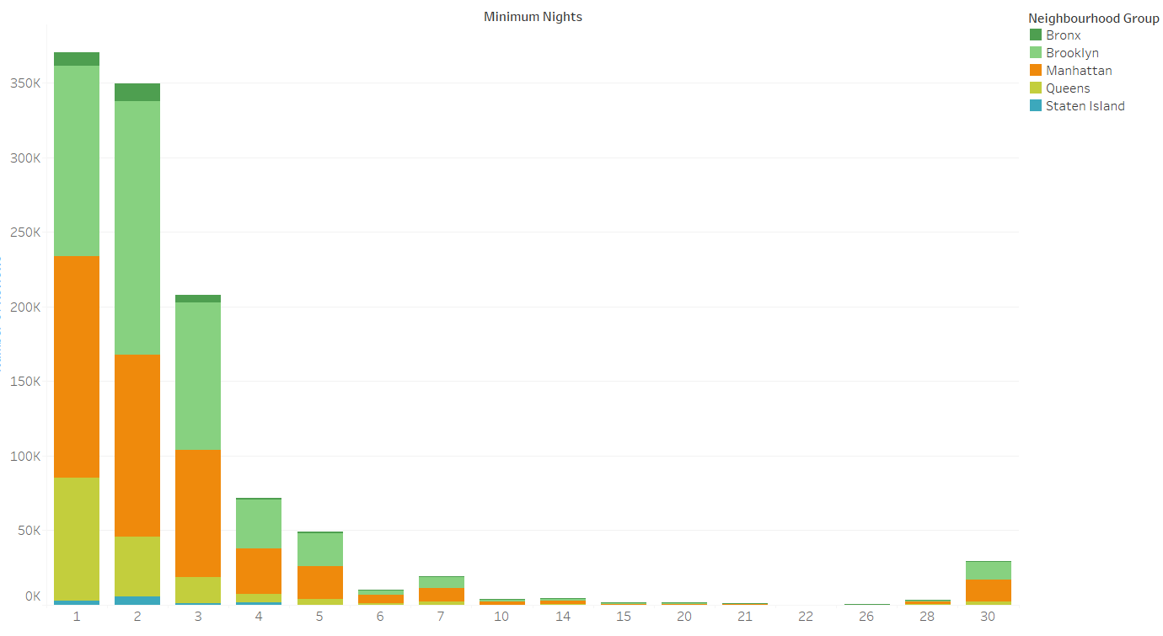

Other Insights
The longer, the customer stays, the higher they paid.
Most of the customers, would prefer the stays of 1-2 nights across boroughs.
It is very important to encourage longer stays especially during holiday/ festive seasons.

Slide 14



Data Assumptions
Revenue
Post COVID
Reviews
Assumed that pre-COVID period data with achieved revenue.
The strategies and insights are to be implemented post COVID period and the demand will increase.
The number of reviews indicates the demands.
Thank You

